Slide 1
Unit 0: Lesson 1 – Introduction to Precision Agriculture
Notes:
In this first lesson, we’ll explore what precision agriculture is and the key technologies that drive it. This introductory module is freely available for anyone to access.
Precision agriculture uses advanced technology to enhance profitability while minimizing environmental impact. This lesson provides a broad overview of the concepts and tools that will be covered in greater depth throughout the rest of the curriculum.
If you're interested in accessing the full suite of lessons please reach out to Katelyn Groe at kgroe@iastate.edu.

Slide 2
Learning Objectives
By the end of this lesson, students will be able to:
Explain what the term “Precision Agriculture” means.
List technologies that are commonly defined as being a part of precision agriculture.

Slide 3
What is Precision Agriculture?
“A suite of technologies that may reduce input costs by providing the farm operator with detailed spatial information that can be used to optimize field management practices”
- United State Department of Agriculture
Notes:
The term precision agriculture, also known as precision farming, has grown in popularity over the past two decades, but what does it actually mean? Depending on who you ask, the definition can vary.
For some, precision agriculture means using satellites, sensors, and digital maps to do what past generations of farmers managed with keen observation, hands-on experience, and memory. For others, it represents the future of farming, where every input (seed, fertilizer, herbicide, etc.) is applied precisely where and when it's needed to reduce waste, boost profits, and protect the environment. Shown on this slide is the definition of precision agriculture according to the USDA.
While technology plays a key role, it’s important to understand that precision agriculture doesn’t replace the farmer’s decision-making, it enhances it. At its core, precision agriculture is about making better-informed decisions to improve yields, reduce environmental impact, and increase overall efficiency.
Precision agriculture is often associated with tools and systems such as:
GPS (Global Positioning Systems)
GIS (Geographic Information Systems)
Autosteer systems
Yield monitors
Variable-rate applications
Each of these technologies will be explored in greater detail in later lessons.

Slide 4
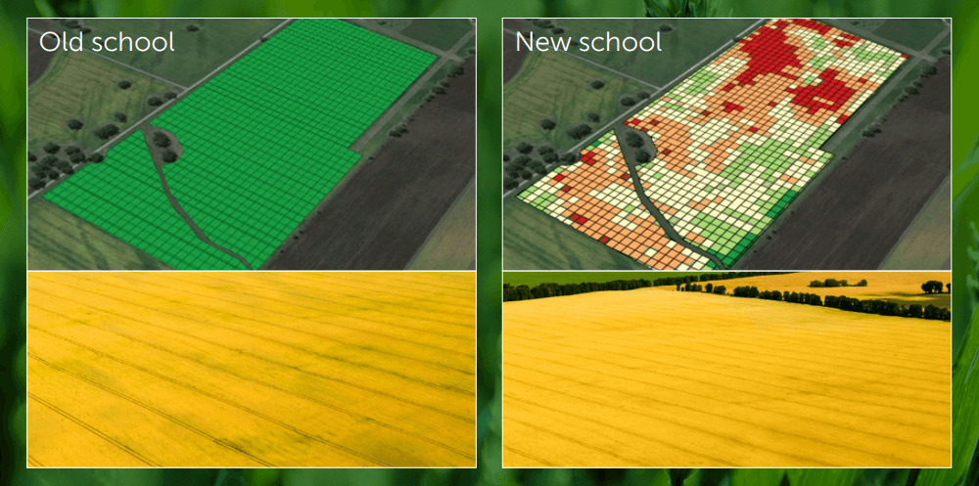
Traditional vs Precision farming
Notes:
The primary difference between traditional farming and precision farming lies in how fields are managed.
In traditional farming, the entire field is treated as one uniform area. Inputs like fertilizer, seed, and water are applied evenly across the whole field, based on average conditions. While this method is simple and familiar, it often overlooks the natural variability within a field—areas that may need more or less attention.
Precision farming, on the other hand, takes a site-specific approach. It recognizes that no two parts of a field are exactly alike. By using technology such as GPS, sensors, and data maps, farmers can analyze variations in soil, moisture, crop health, and yield across the field. This allows them to apply the right amount of inputs in the right place at the right time, reducing waste, increasing profitability, and minimizing environmental impact.
Think of it this way:
Traditional farming uses a one-size-fits-all strategy.
Precision farming uses a custom-tailored plan for every part of the field.
This shift from field-wide management to zone-specific decision-making is one of the most significant transformations in modern agriculture.

Slide 5
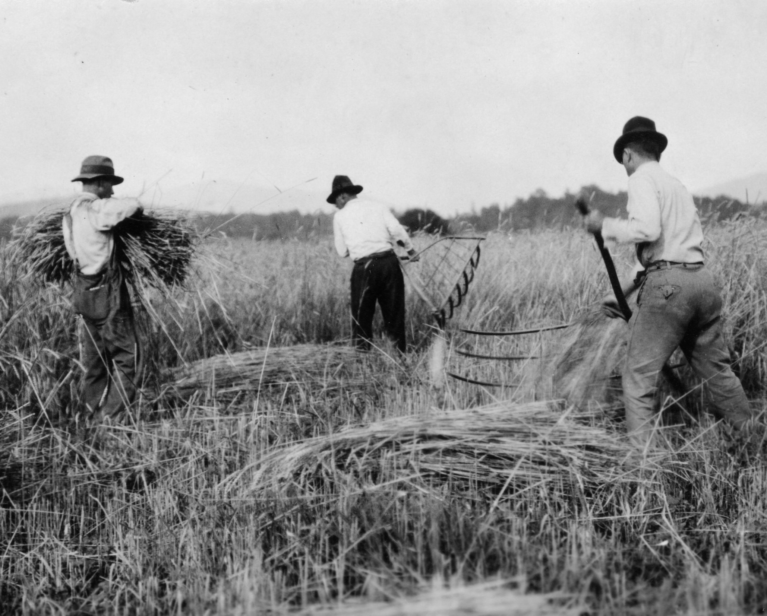
Mechanization of Agriculture
Notes:
The idea of managing small areas within a field separately isn’t new, it's actually one of the oldest concepts in farming. Early farmers paid close attention to each seed they planted and the soil around it. In many ways, they were already practicing a form of precision agriculture. Every seed was placed by hand, every plant observed, and every decision made with specific spots in mind.
However, the 20th century brought dramatic changes to agriculture. With the rise of mechanization, large tractors and implements transformed the way farmers worked. Instead of managing crops on a plant-by-plant or row-by-row basis, entire fields began to be treated as a single management unit.
This shift made sense for the time: large equipment allowed farmers to work faster, cover more ground, and manage more acres with less labor. The time savings and efficiency gains far outweighed the benefits of managing smaller sections of a field. Speed and scale became the focus.
But now, with today’s technology, we’re circling back, revisiting those early principles of site-specific management, this time powered by GPS, sensors, and data.

Slide 6
The Need for Precision Agriculture
Notes:
Farmers have long understood that not all parts of a field perform the same. Some areas consistently yield more, others dry out too quickly, and some hold onto nutrients better than others. These patterns of variability have always existed, but until recently, they were difficult to measure and manage.
That’s where precision agriculture comes in.
Thanks to advances in technology, we can now collect detailed data on soil conditions, crop health, and yield potential across every part of a field. Tools like GPS, sensors, and satellite imagery make it possible to map this variability and take targeted action. Instead of applying the same treatment across an entire field, inputs like seed, fertilizer, and irrigation can now be adjusted zone by zone.
This matters, especially for farmers working with limited resources, because it helps them maximize productivity, reduce waste, and make more informed, data-driven decisions.
The goal of this lesson is to introduce you to the technologies that make this possible. The rest of this program will take a deeper dive into how these tools work and how they can be applied in real-world agriculture to improve both profitability and environmental outcomes.

Slide 7
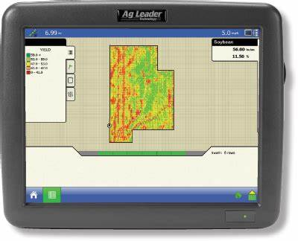
Yield Monitor
An in-cab device that displays crop yields live as the machine is harvesting. Allows the producer to visualize how yields change over small areas of the field.
Commercialized around 1993
Notes:
A yield monitor is an in-cab device that shows crop yields in real time while the machine is harvesting. As the combine moves through the field, the monitor collects data on how much crop is being harvested from each specific area.
This technology allows farmers to see exactly how yields vary across different parts of the field. Instead of just knowing the average yield for the whole field, farmers can understand which areas are most productive, and which ones aren’t.
Yield monitors help answer important questions like:
Are some parts of the field underperforming?
Is fertilizer being used efficiently?
Could soil type or drainage be affecting yields?
This kind of insight is essential for making smarter decisions in future growing seasons.
Yield monitors were commercialized in the early 1990s, and they were one of the first major tools that made precision agriculture possible.

Slide 8
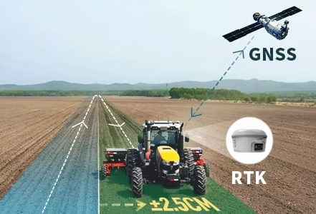
Guidance Systems
Equipment that reduces field overlaps or skips by either (1) instructing the operator to steer within predefined boundaries or (2) fully automates nearly all steering operations
Commercialized in the mid to late 1990s
Notes:
Guidance systems are one of the most impactful tools in precision agriculture. They use satellite-based positioning (GNSS) to help equipment follow precise paths through the field, improving accuracy and efficiency in everything from planting to spraying to harvesting.
There are two main types of guidance systems:
Assisted (or manual) guidance – The system gives the operator feedback, often through a lightbar or screen, to help them steer along straight lines. It’s still up to the operator to turn the wheel, but they’re guided by real-time GPS signals to reduce guesswork.
Autosteer (fully automated guidance) – The system takes full control of the steering, automatically keeping the machine on the correct path. The operator can focus more on monitoring equipment performance and less on manually steering. This technology can keep machines on track with an accuracy of just a few centimeters when using high-precision correction signals like RTK (Real-Time Kinematic).
Why it matters:
Reduces overlap and skips – No more double-applying fertilizer or missing spots with the sprayer.
Increases efficiency – You can work faster and cover more ground with fewer mistakes.
Saves money – Less fuel, fewer inputs wasted, and lower wear on equipment.
Reduces fatigue – Autosteer systems lower stress during long days in the field by doing the driving for you.
Enables long-term planning – Lines can be saved and reused year after year, helping with strip-till, planting between last year’s rows.
These systems were commercialized in the mid-to-late 1990s, and today, they’re nearly standard on new equipment. Even older tractors can be upgraded with guidance kits to take advantage of these benefits.

Slide 9
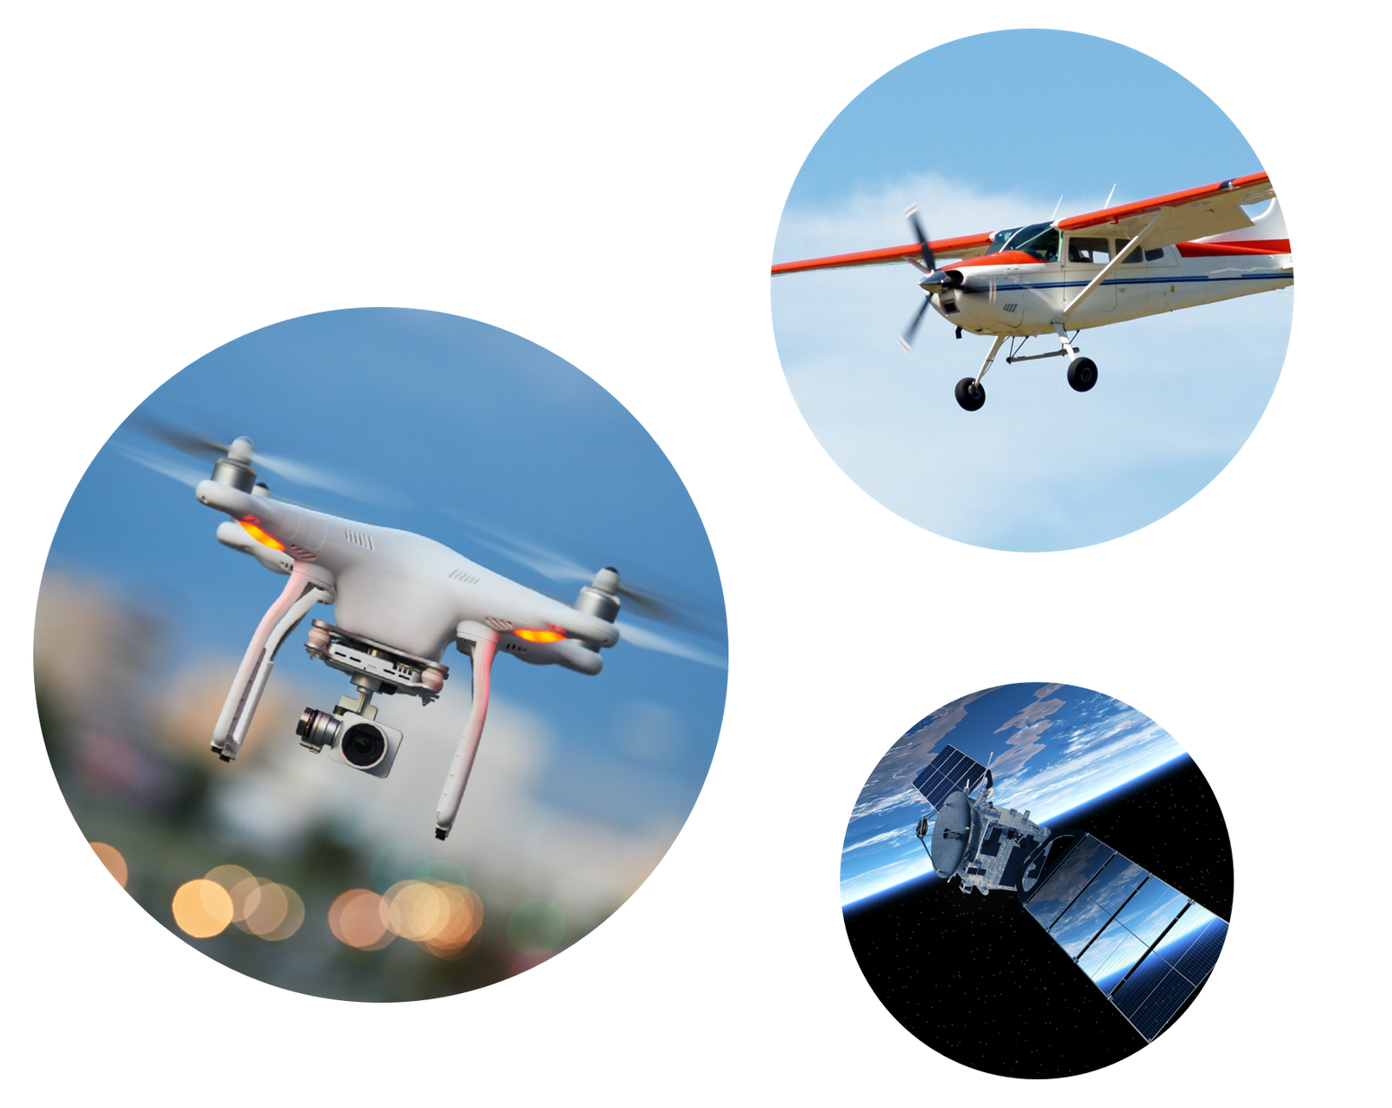
Drones, Aircraft or Satellite Imagery
These kinds of imagery are remotely sensed data collected from satellite, crewed aircraft or a small unmanned aerial vehicle. Imagery is used to make farm management decisions
Satellite imagery commercialized around the 1970s
Commercial drones have been around since the mid 2000s
Notes:
One of the most powerful tools in precision agriculture is the ability to “see” the field from above. These aerial views come from remotely sensed imagery, which means data is collected from a distance, usually by satellite, airplane, or drone.
Each method has its strengths:
Satellites can capture large areas and track changes over time.
Crewed aircraft can fly specific missions for higher-resolution imagery.
Drones can capture highly detailed images and are easy to deploy on-demand.
These images help farmers detect issues they may not notice from the ground, like poor drainage, pest outbreaks, or nutrient deficiencies. By analyzing these patterns, they can make better decisions about where to apply inputs, how to manage crops, and when to take action.
A quick timeline:
Satellite imagery became commercially available in the 1970s.
Commercial drones began to rise in popularity in the mid-2000s.
Today, remote sensing is an essential part of precision agriculture. It helps turn visual information into action

Slide 10
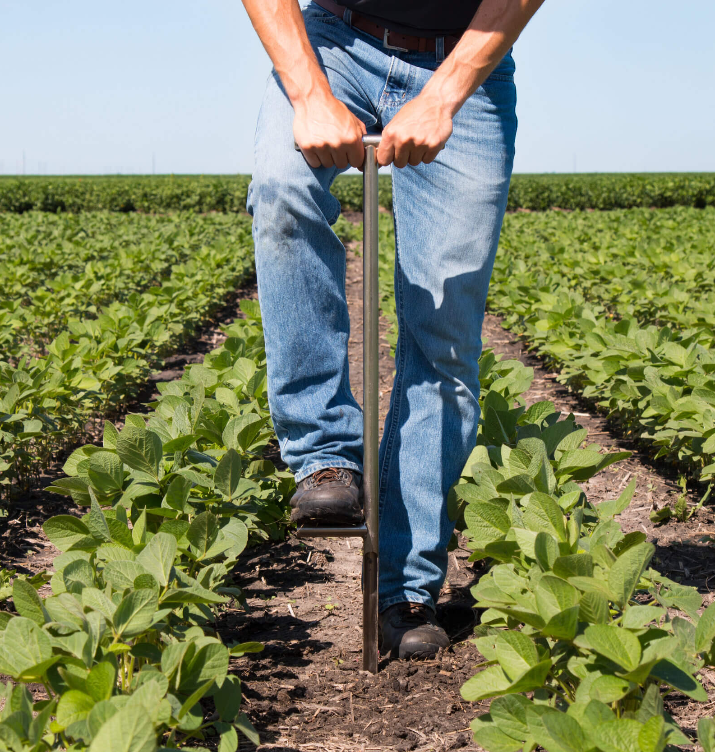
Precision Soil Sampling
Soil core samples are taken from grids or other areas, typically less than 10 acres in area. Samples are analyzed in laboratories to determine the soils physical or chemical properties
Commercialized around 1993
Notes:
Soil sampling is one of the key practices in modern precision agriculture.
What you see here is a farmer using a soil probe to collect what's called a soil core sample. These samples are collected from a grid pattern across a field, or sometimes from smaller management zones, and each sample usually represents an area of 10 acres or less.
Why do we do this? Because soil fertility can vary a lot across a field, and in order to manage those differences effectively, we need to know exactly what we’re working with.
The soil samples are sent to a lab where scientists analyze their physical and chemical properties, things like nutrient levels, pH, organic matter, and more. That data helps farmers know where to apply fertilizers and how much to apply.
This practice became common in agriculture around 1993, and it was one of the first major tools that allowed farmers to make data-driven decisions for different parts of their fields, moving away from treating the entire field the same."

Slide 11
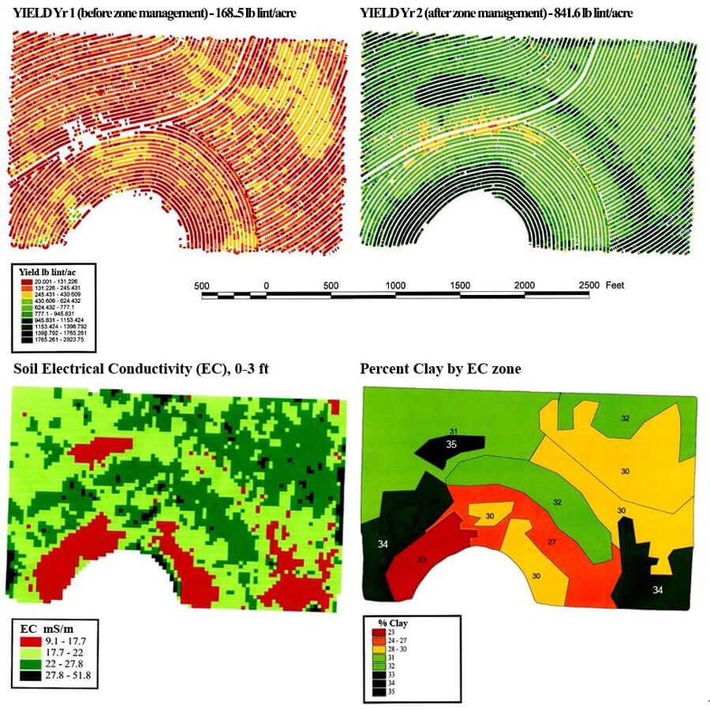
Yield and Soil Maps
Yield maps are physical maps that visually represent crop yields within and across fields. Likewise, soil maps display physical and/or chemical attributes of soil
Commercialized around 1993-1994
Notes:
In precision agriculture, maps are powerful tools for turning field data into insights.
A yield map shows how crop production varies across different areas of a field. It’s created using data collected during harvest, usually from a yield monitor in the combine, and allows farmers to spot trends like low-performing spots or areas that consistently produce more.
A soil map gives insight into the field’s physical and chemical properties. These maps may include data on soil texture, organic matter, pH, or electrical conductivity (EC). Knowing this information helps farmers make better decisions about fertilizer application, seeding rates, and even drainage improvements.
Together, yield and soil maps help farmers understand why certain parts of their field perform better than others, and what actions they can take to improve outcomes.
These technologies started becoming commercially available in the early 1990s and remain a cornerstone of precision agriculture today.

Slide 12
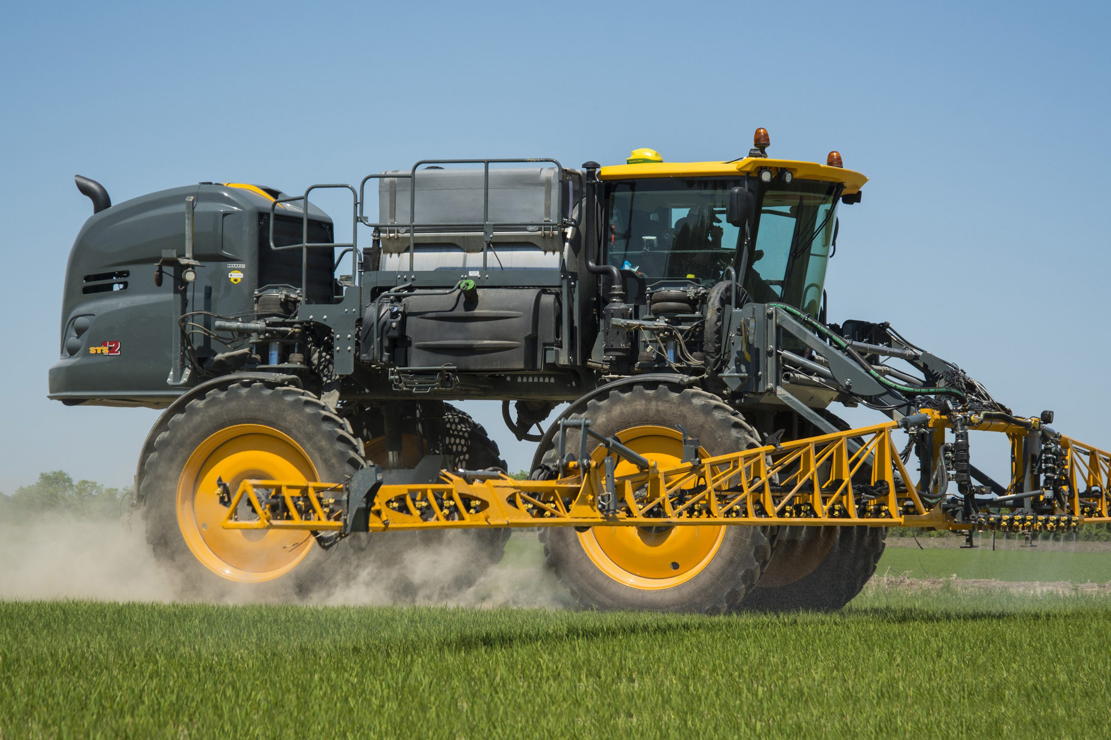
Variable Rate Technology
Equipment that provides custom applications of seed, lime, fertilizer, and/or pesticides as rates that can change over small distances
Commercialized around 1995
Notes:
Variable Rate Technology, often called VRT, is a key part of precision agriculture. It refers to equipment that can automatically adjust how much product it applies, like seed, lime, fertilizer, or pesticides, as it moves across the field.
Rather than applying the same rate everywhere, VRT allows different parts of the field to receive exactly what they need. For example:
In a low-yielding area, a farmer might reduce the seed population or fertilizer rate to avoid wasting inputs.
In a high-potential zone, they might apply more to maximize yield.
These decisions are usually guided by prescription maps, which are created using data from tools like yield maps, soil sampling, and remote sensing imagery.
Some systems can even make real-time adjustments using on-the-go sensors that detect crop needs or soil conditions instantly.
VRT helps farmers:
Save money by not overapplying expensive inputs
Improve efficiency and sustainability
Protect the environment by reducing runoff and overuse
Boost yields by customizing inputs for each zone’s potential
This technology began to take off in the mid-1990s, and it's now built into many modern planters, sprayers, and spreaders.

Slide 13
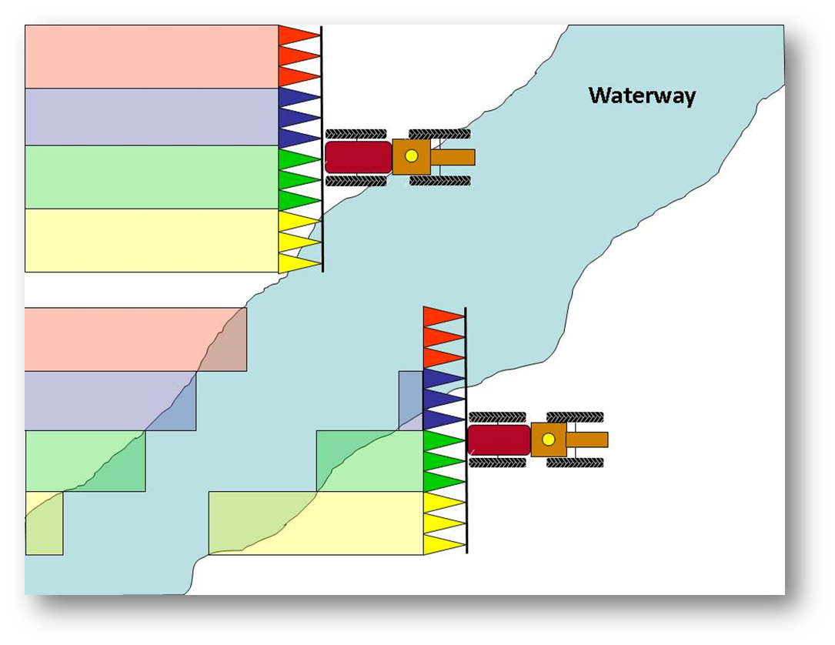
Automated Section Control
A type of variable rate technology that automatically shuts off a portion of the equipment (e.g., boom section, nozzle on sprayer, or row on planter) when the portion is in a part of the field that does not require input application
Commercialized in 2003
Notes:
Automated section control is a smart technology that helps reduce overlap and waste during field operations. It’s a type of variable rate technology that automatically turns off parts of a machine, like sprayer nozzles, planter rows, or boom sections, when they’re passing over an area that’s already been treated or doesn’t need application (like a waterway or headland).
Here’s how it works:
The system uses GPS and field maps to track the machine’s location in real time.
As the equipment moves through the field, it automatically shuts off sections when they reach an area that’s already been covered, or where inputs aren’t needed.
Once the equipment moves back into a zone that needs treatment, that section turns back on, all without the operator needing to press a button.
This technology is especially useful for irregularly shaped fields or fields with curves, point rows, or waterways. It helps farmers:
Avoid double applications (which wastes inputs and may harm crops)
Save money on seed, chemicals, and fertilizer
Protect the environment by preventing over-application
Reduce operator fatigue during long hours in the field
Automated section control became commercially available around 2003, and it’s now a standard feature on many modern sprayers and planters.

Slide 14
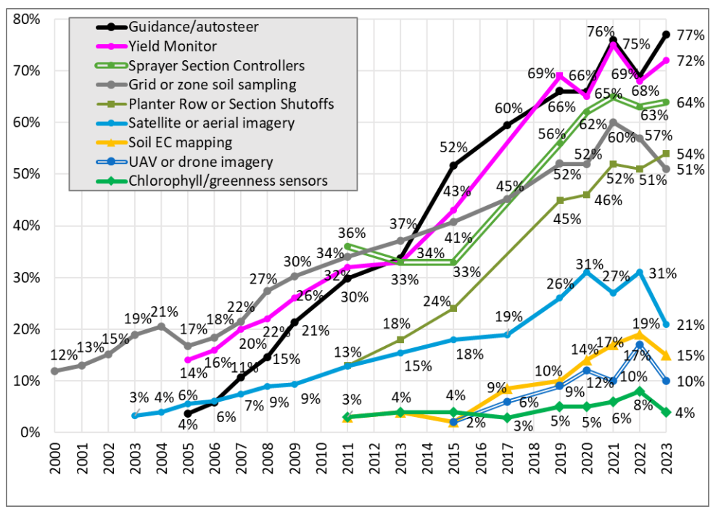
Technology adoption rates across Midwest acres in 2023
Yield Monitors – 72%
Guidance/Autosteer – 77%
Machine Section control
Sprayer – 64%
Planter – 54%
Site specific soil sampling – 51%
Imagery
Satellite or aerial – 21%
Drone – 10%
Source: 2023 Croplife Precision Ag Services Dealer Survey
Notes:
These numbers show how widespread precision ag technology has become across farms in the Midwest. This is no longer cutting-edge, it’s common practice
Precision ag is already deeply integrated into modern farming. These technologies are being used on a majority of the acres in our region, and that number will only keep growing.
If students are going to be part of the next generation of farmers, agronomists, ag engineers, equipment techs, or ag business professionals, they need to be introduced to these tools early. Waiting until college, or worse, the job site, is too late.
This is why it’s so important to start teaching these concepts now, in high school ag classrooms. Understanding GPS, data-driven decisions, and smart equipment is becoming just as essential as knowing how to operate a tractor.

Slide 15
Summary
Precision agriculture uses technology to optimize field-level management with detailed spatial data
Technologies include yield monitors, imagery, soil sampling, yield and soil maps, variable rate application, automated section control, and guidance systems
These tools help farmers make better decision and reduce input costs
Many of these technologies were commercialized in the 1990s and early 2000s and are now standard on many farms.

